Slide 1
Time series classification using multi-dimensional motif in sensor data
Abhishek Suntwal, Amirkhosro Vosughi
Cpts 483 Project, Fall 2017
Notes:
Template-Primary on 201-shield

Slide 2
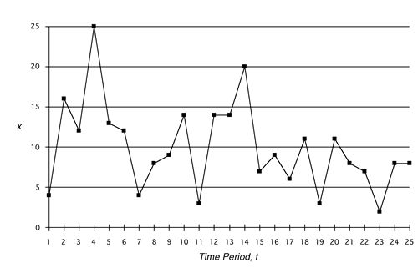
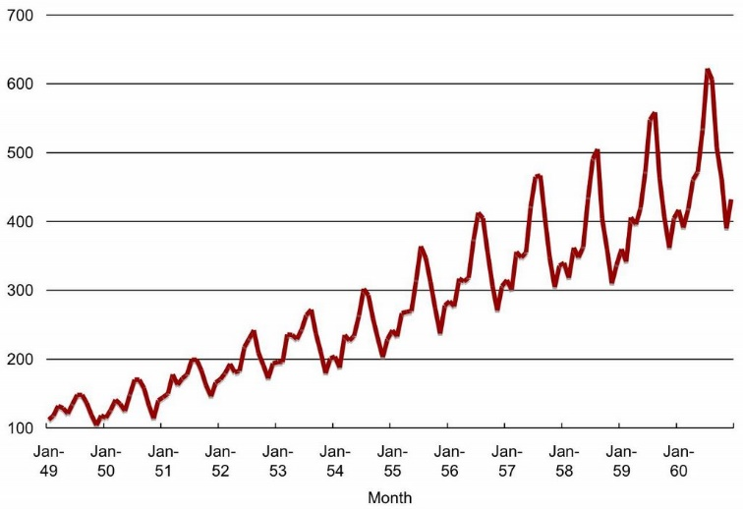
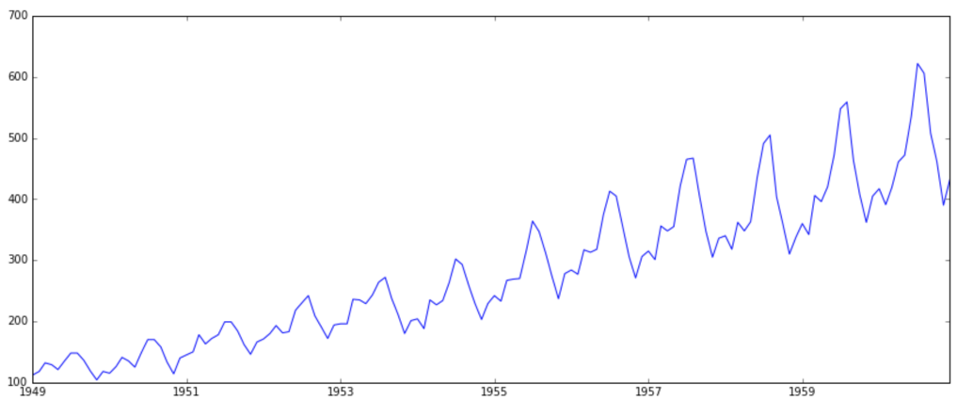
Introduction:
Time Series:
  • A series of data points indexed in time order
Usage:
  sensor data
  Medical
  Biological
  IoT
  System and Signal
  Market and Business
  Climate
Notes:
Template-Primary on 201-shield

Slide 3
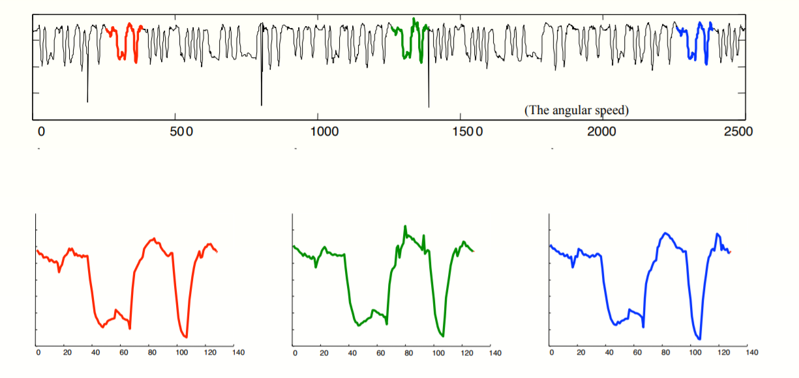
Introduction:
Motifs:
  • Repeated pattern in Time series
  Similarity in a time window
    Definition of similarity (Euclidian distance, Dynamic time Wrapping)
    Choose appropriate time window (depends on data series, experimental)
  Motifs set
Notes:
Template-Primary on 201-shield

Slide 4
Introduction:
Matrix Profile:
  • easy way to extracting useful structure of Data
  Computationally and storage efficiency
  Easily assemble and extendable
Main idea:
  Store the minimum distance and the relevant index for each point rather than storing all distance
  Can be used to find: Motifs, Discords, Abnormality
Expanded by UCR group
Notes:
Template-Primary on 201-shield

Slide 5
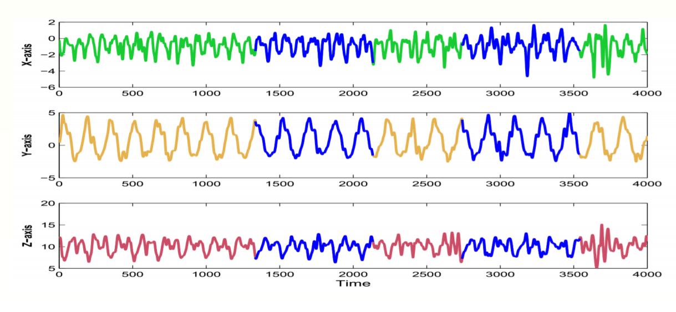

Introduction:
Multi dimensional Motifs:
  • co-occurrence of motifs in different Time series
  Time series measure different aspect of same process
  co-occurred motifs are related to same event
For example:
  Accelerometer, gyroscope and magnetometer data of watch and cellphone of person who climb up the steps or running
Notes:
Template-Primary on 201-shield

Slide 6
Problem Formulation
We are interested:
  Recognizing activity for new set of Time-series using Multi-dimensional motifs
  Can be viewed as classification problem
Dataset
  From some wearable sensor
  Accelerometer, Gyroscope, Magnetometer, …
  For set of Activities (Climbing up/Down, Running )
We choose 4 activity
Accelerometer on shin data sensor in 3 axis
Window is 200
Notes:
Template-Primary on 201-shield

Slide 7
Solution approach
  Find single dimensional motifs(top 10)
  Merge if any of the similar motifs recognized as different motifs due to time shifts
    For merging: cross covariance of two discrete time sequence: To be able to discover time shift
  Find Multi dimensional Motif (Construct weighted Adjacency Graph)
    Each motifs set is node
    Edge’s weight based on co-occurrence of motif sets 0<E<1
    If co-occurrence exactly in same time: Edge equal to 1
    If no co-occurrence: Edge equal to 0
    (details on report)
Notes:
Template-Primary on 201-shield

Slide 8
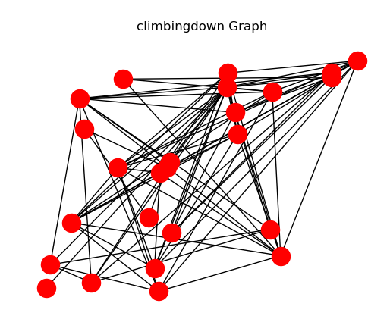
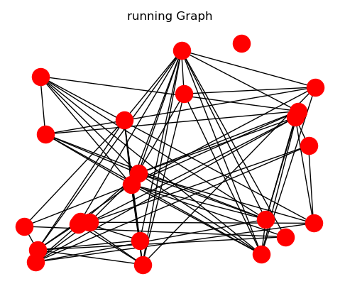
Adjacency Graph
Solution approach

Slide 9
Solution approach
Find cliques through adjacency graph
  Highly connected subgraphs
  Shows events in process that leads to repeated pattern in many sensors
  Using Algorithm 457 (C. Bron and J. Kerbosch. )
  Choose the Cliques that have motifs set from all sensor
  Remove Too short or long Cliques
    Main Part Repeated Cliques
Notes:
Template-Primary on 201-shield

Slide 10
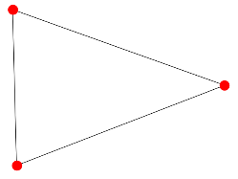
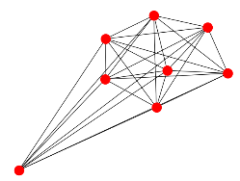
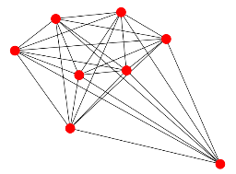
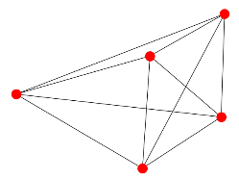
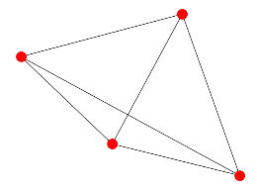
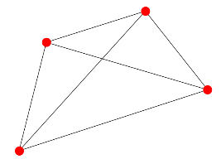
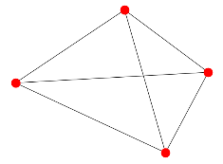
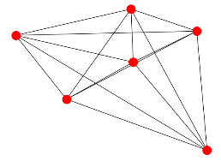
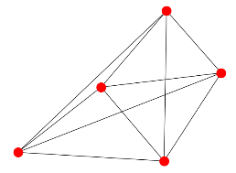
Graphs of cliques(climbingdown)
[4, 10, 0]
[21, 2, 13, 17, 0, 8, 18, 19]
[21, 2, 13, 17, 0, 8, 18, 5]
[21, 3, 15, 22, 7]
[21, 3, 15, 6]
[21, 6, 24, 9]
[21, 6, 24, 15]
[21, 2, 13, 17, 1, 5]
[21, 6, 24, 11, 12]

Slide 11
Solution approach
Classifier:
Training: Finding the Multi-dimensional motifs for each activity
Testing: Given new set of Time series, Recognize the activity
  Searching in test time series for pattern that are close to multi-dimensional motifs
  Averaging over distance of all Cliques and all motifs set of each activity
  Choose the minimum Distance as the best estimate
  Practical implementation points:
  Normalizing Signal before computing distance (zero Mean and one Variance)
Notes:
Template-Primary on 201-shield

Slide 12
Results
We had 5 Time series set
Use one for training the Classifier
Four of them are used to test
Confusion Matrix
 | Climbing up | Climbing Down | Running | Jumping
Climbing up | 3 | 1 | 0 | 0
Climbing Down | 0 | 4 | 0 | 0
Running | 0 | 0 | 4 | 0
Jumping | 0 | 0 | 0 | 4
Notes:
Template-Primary on 201-shield

Slide 13
Results
We had 5 Time series set
Use one for training the Classifier
Four of them are used to test
 | Climbing up | Climbing Down | Running | Jumping | Walking
Climbing up | 2 | 0 | 0 | 0 | 2
Climbing Down | 0 | 2 | 0 | 0 | 2
Running | 0 | 0 | 4 | 0 | 0
Jumping | 0 | 0 | 0 | 4 | 0
Walking | 0 | 0 | 0 | 0 | 4
Notes:
Template-Primary on 201-shield

Slide 14
Conclusion & Future works
Classify time series more confidently with Multi-dimensional motifs
Good primary results
Not works well for similar activities (Walking & Climbing Down)
Suggestion for increasing Margin:
  Use more sensors
  Check the frequently repeating of Multi-dimensional motifs
  Use different Distance functions
  Play with our algorithm and improve them (Adjacency Matrix Construction, Finding Cliques, Classification approach)
Can be used for Fault detection in control systems
Notes:
Template-Primary on 201-shield

Slide 15
References:
Assefaw Gebremehdin, CPST 483, Lecture slides
Matrix Profile I: All Pairs Similarity Joins for Time Series: A Unifying View that Includes Motifs, Discords and Shapelets. Chin-Chia Michael Yeh, Yan Zhu, Liudmila Ulanova, Nurjahan Begum, Yifei Ding, Hoang Anh Dau, Diego Furtado Silva, Abdullah Mueen, Eamonn Keogh (2016). IEEE ICDM 2016.
Software package, http://www.cs.ucr.edu/~eamonn/MatrixProfile.html
C. Bron and J. Kerbosch. Algorithm 457: Finding all cliques of an undirected graph
Notes:
Template-Primary on 201-shield

Slide 16
Question
Thank You

